Slide 1
Unemployment and
Inflation
Nature of Unemployment

Slide 2
Unemployment
Nature of Unemployment

Slide 3
NATURE OF UNEMPLOYMENT
The meaning of ‘unemployment’
Unemployment: those of working age who are without work, but who are available for work at current wage rates.
It excludes students above 18 years, housewives, discouraged workers (those who look for jobs and give up their search in frustration), etc.
Notes:
8

Slide 4
NATURE OF UNEMPLOYMENT
The meaning of ‘unemployment’
(ILO/OECD)
  In this measure, the unemployed are defined as people of working age who are without work, available to start work within two weeks and actively seeking employment or waiting to take up an appointment
Notes:
8

Slide 5
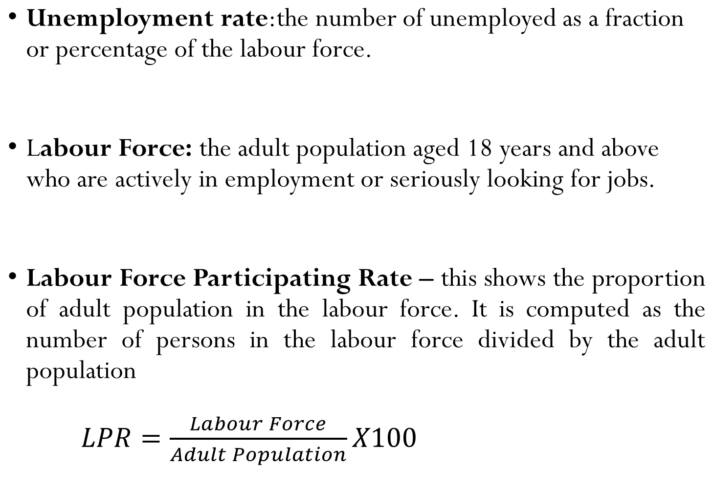
NATURE OF UNEMPLOYMENT
Notes:
8

Slide 6
NATURE OF UNEMPLOYMENT
Underemployment - This constitutes the section of the labour force seeking for full-time paid employment but unfortunately, the structure of the employment permit them to work for only part-time or are employed below capacity.
Claimant Unemployment: This is simply a measure of those in receipt of unemployment related benefits
Notes:
8

Slide 7
NATURE OF UNEMPLOYMENT
The duration of unemployment
What determines the average duration of unemployment? There are three important factors here.
Notes:
8

Slide 8
NATURE OF UNEMPLOYMENT
The duration of unemployment
Determinants of average duration of unemployment
  The rate of inflow and outflow from the stock of unemployment
Notes:
8

Slide 9
Flows into and out of unemployment
From jobs
From outside the labour force
People made redundant
People sacked
People temporarily laid off
People resigning
School/college leavers
People returning to the labour force (e.g. after raising children)
INFLOWS
(per period of time)
UNEMPLOYMENT

Slide 10
Flows into and out of unemployment
From jobs
From outside the labour force
People made redundant
People sacked
People temporarily laid off
People resigning
School/college leavers
People returning to the labour force (e.g. after raising children)
INFLOWS
(per period of time)
UNEMPLOYMENT
To jobs
OUTFLOWS
(per period of time)
To outside the
labour force
People taking new jobs
People returning to old jobs who had been temporarily laid off
People who have become disheartened and give up looking for a job
People who have reached retirement age
People who temporarily withdraw from labour force (e.g. to raise a family)
People who emigrate
People who die

Slide 11
NATURE OF UNEMPLOYMENT
The duration of unemployment
  Determinants of average duration of unemployment
  inflows to and outflows from the stock of unemployment
  Note: the duration of unemployment (DU) will equal the stock of unemployment (U) as a proportion of the outflow (F) from unemployment. DU=U/F
  The number unemployed (the size of the stock of unemployment).
Notes:
8

Slide 12
NATURE OF UNEMPLOYMENT
The duration of unemployment
  Determinants of average duration of unemployment
  inflows to and outflows from the stock of unemployment
  The phase of the business cycle
  At the onset of a recession, unemployment will rise, but average length of unemployment is likely to be short
  Lasted recession would mean longer duration of unemployment
Notes:
8

Slide 13
NATURE OF UNEMPLOYMENT
The composition of unemployment
  by geographical region, by sex, by age, by ethnic groups
The costs/effects of unemployment
  Loss of self – esteem
  Social problems/vices: e.g. prostitution, armed robbery
  Loss of national output
  Brain drain
  Low standard of living
Notes:
9

Slide 14
NATURE OF UNEMPLOYMENT
The costs/effects of unemployment
  Parallel markets may develop – people will be willing to offer themselves for employment at wage rate lower than the equilibrium wage rate
  Loss of tax revenues
  Effects on the family (dependents and divorce)
Notes:
9

Slide 15
Unemployment
Causes of Unemployment

Slide 16
CAUSES OF UNEMPLOYMENT
Unemployment and the labour market
  Aggregate demand and supply of labour
  Aggregate supply of labour curve shows the number of workers willing to accept jobs at each wage rate. The curve is relatively inelastic (why?)
  Aggregate demand for labour curve shows the total demand for labour in the economy at different average real wage rates.
  Real average wage rate is plotted on the vertical axis.
Notes:
10

Slide 17


Aggregate demand and supply of labour
AS_{L}
Average (real) wage rate
AD_{L}
O
No. of workers

Slide 18
CAUSES OF UNEMPLOYMENT
Unemployment and the labour market
  aggregate demand and supply of labour
  Equilibrium in the model
  AD=AS
Notes:
10

Slide 19
Aggregate demand and supply of labour
AS_{L}
Average (real) wage rate
W_{e}
AD_{L}
O
Q_{e}
No. of workers

Slide 20
CAUSES OF UNEMPLOYMENT
Unemployment and the labour market
  aggregate demand and supply of labour
  equilibrium in the model
  Disequilibrium unemployment (2 conditions)
  The Aggregate supply of labour much exceed the aggregate demand
  There must be a “stickiness” in wages. In other words, the wage rate must not immediately fall to the equilibrium wage.
Notes:
10

Slide 21
Disequilibrium unemployment
AS_{L}
Disequilibrium
unemployment
Average (real) wage rate
B
A
W₂
W_{e}
AD_{L}
O
Q₂
Q₁
No. of workers

Slide 22
CAUSES OF UNEMPLOYMENT
Unemployment and the labour market
  aggregate demand and supply of labour
  equilibrium in the model
  disequilibrium unemployment
  Equilibrium (“natural”) unemployment
  It is the difference between those who would like employment at the current wage rate and those willing and able to take a job
Notes:
10

Slide 23
Equilibrium unemployment
AS_{L}
Average (real) wage rate
e
W_{e}
AD_{L}
O
Q_{e}
No. of workers

Slide 24
Equilibrium unemployment
AS_{L}
N
Average (real) wage rate
e
d
W_{e}
Equilibrium
unemployment
AD_{L}
O
Q_{e}
Q₂
No. of workers

Slide 25

Equilibrium and disequilibrium unemployment
AS_{L}
Average (real) wage rate
e
W_{e}
AD_{L}
O
Q_{e}
No. of workers

Slide 26
Equilibrium and disequilibrium unemployment
AS_{L}
Disequilibrium
unemployment
Average (real) wage rate
b
a
W₂
e
W_{e}
AD_{L}
O
No. of workers

Slide 27
Equilibrium and disequilibrium unemployment
AS_{L}
Disequilibrium
unemployment
N
Average (real) wage rate
b
a
c
W₂
e
Equilibrium
unemployment
W_{e}
AD_{L}
O
No. of workers

Slide 28
CAUSES OF UNEMPLOYMENT
Disequilibrium unemployment
Causes of disequilibrium unemployment
  Real-wage (classical) unemployment (occurs when trade unions use their monopoly power to drive wages above the market clearing level.
  It could also be caused by the government setting the national minimum wage too high)
Notes:
10

Slide 29

Real-wage unemployment
AS_{L}
Average (real) wage rate
b
b’
a
W₁
W_{e}
AD_{L 2}
AD_{L}
O
Q₂
Q_{e}
Q₁
No. of workers

Slide 30
CAUSES OF UNEMPLOYMENT
Disequilibrium unemployment
  real-wage (classical) unemployment
  Demand-deficient (cyclical) unemployment
    Unemployment caused by a fall in aggregate demand with no corresponding fall in the real wage rate.
Notes:
10

Slide 31
Demand-deficient unemployment
AS_{L}
Sticky wages
Demand-deficient unemployment
Average (real) wage rate
W₁
Reduction in aggregate demand
W₂
AD_{L 1}
AD_{L 2}
O
Q₂
Q₁
No. of workers

Slide 32
CAUSES OF UNEMPLOYMENT
Disequilibrium unemployment
  real-wage (classical) unemployment
  demand-deficient (cyclical) unemployment
  Unemployment arising from a growth in the labour supply
Notes:
10

Slide 33
CAUSES OF UNEMPLOYMENT
Equilibrium unemployment
  Frictional (search) unemployment
  Unemployment that occurs as a result of imperfect information in the labour market.
  It often takes time for workers to find jobs (even though there are vacancies) and in the meantime they are unemployed
Notes:
12

Slide 34

Average duration of unemployment
Wage rate offered (W_{o})
Wage rate
Equilibrium
duration
Wage rate acceptable
to a worker (W_{a})
O
T _{e}
Length of time of unemployment

Slide 35
CAUSES OF UNEMPLOYMENT
Equilibrium unemployment
  frictional (search) unemployment
  Structural unemployment
    Unemployment that arises from changes in the pattern of demand or supply in the economy.
    People made redundant in one part of the economy cannot immediately take up jobs in other parts (even though there are vacancies).
    Occupational and geographical immobility of labour
Notes:
12

Slide 36
CAUSES OF UNEMPLOYMENT
Equilibrium unemployment
  frictional (search) unemployment
  Structural unemployment
    changing pattern of demand
Notes:
12

Slide 37
CAUSES OF UNEMPLOYMENT
Equilibrium unemployment
  frictional (search) unemployment
  Structural unemployment
    changing pattern of demand
    regional unemployment
Notes:
12

Slide 38
CAUSES OF UNEMPLOYMENT
Equilibrium unemployment
  frictional (search) unemployment
  Structural unemployment
    changing pattern of demand
    regional unemployment
    technological unemployment
Notes:
12

Slide 39
CAUSES OF UNEMPLOYMENT
Equilibrium unemployment
  frictional (search) unemployment
  Structural unemployment
    changing pattern of demand
    regional unemployment
    technological unemployment
Notes:
12

Slide 40
CAUSES OF UNEMPLOYMENT
Equilibrium unemployment
  frictional (search) unemployment
  Seasonal unemployment
    It occurs when the demand for certain types of labour fluctuates with the seasons of the year
    Example: Agriculture
  Residual Unemployment
    Physical and/mental disabilities
Notes:
12

Slide 41
CURES FOR UNEMPLOYMENT
  Demand Management/Demand Side Policies: Fiscal and monetary policies are intended to increase aggregate demand and, therefore the equilibrium level of national income.
  Supply – Side Policies: Policies are intended to increase the economy’s potential rate of output by increasing the supply of factor inputs, such as labour inputs and capital inputs, and by increasing productivity
Notes:
12

Slide 42
Question
Using the concepts of equilibrium and disequilibrium unemployment explain why the labour market does not clear.

Slide 43
Unemployment and Inflation
Aggregate Demand, Aggregate Supply and the Price Level

Slide 44
AD, AS and the PRICE LEVEL
The aggregate demand curve: It is the total level of spending in the economy
It consists of four elements: consumer spending (C), private investment (I), government expenditure on goods and services (G) and expenditure on exports (X) less expenditure on imports (M).

Slide 45
Aggregate demand Curve
Price level
AD
O
National output

Slide 46
AD, AS and the PRICE LEVEL
Why the AD curve slopes downwards?
Income effect
Substitution effect
  foreign trade effect
  real balance effect
  interest rate effect
AD can shift to the right (increase in AD) or shift to the left (decrease in AD) due to:
  Changes in consumption, investment, government expenditure or exports minus imports

Slide 47
AD, AS and the PRICE LEVEL
The aggregate demand curve
The aggregate supply curve: The aggregate supply (AS) curve shows the amount of goods and services that firms are willing to supply at each level of prices.

Slide 48
Aggregate Supply Curve
AS
Price level
short-run AS curve
O
National output

Slide 49
AD, AS and the PRICE LEVEL
The aggregate demand curve
The aggregate supply curve
Shifts in the aggregate supply curve could be caused by:
  technology
  the labour force
  the stock of capital
  wage rates and other input prices

Slide 50
AD, AS and the PRICE LEVEL
The aggregate demand curve
The aggregate supply curve
Equilibrium

Slide 51
Aggregate demand and aggregate supply
AS
Price level
If the price level is initially P₂, the excess demand will cause price level to rise to P_{e}
P_{e}
b
a
P₂
AD
O
National output

Slide 52
AD, AS and the PRICE LEVEL
The aggregate demand curve
The aggregate supply curve
Equilibrium
  Shifts in the AD curve

Slide 53
AD, AS and the PRICE LEVEL
The aggregate demand curve
The aggregate supply curve
Equilibrium
  shifts in the AD curve
  shifts in the AS curve

Slide 54
Inflation

Slide 55
INFLATION
Inflation is defined as a persistent and appreciable increase in the general price level of goods and services and factors of production. In other words, it is a continuing or persistent tendency for the level of price to rise.
Deflation is the opposite, a persistent tendency for the general price level to fall
The rate of inflation measures the annual percentage increase in prices (CPI)
  The most usual measure is that of consumer prices: i.e. retail prices
Notes:
13

Slide 56
INFLATION
The costs of inflation
  “Shoe Leather cost” and “Menu cost”
  Redistribution effects
  Uncertainty and lack of investment
  Balance of payments worsening
  Resources used to cope with inflation
Notes:
13

Slide 57
Consumer price Index (CPI)
The consumer price index (CPI) is the price of basket of goods and services relative to the price of the same basket in some base year.
It measures, overtime, the cost of buying the same quantity of goods and services
The CPI for any given period is calculated as the current cost of the basket of consumer items divided by the cost of the same basket in the base year
Notes:
13

Slide 58
Consumer price Index (CPI)
A measure of the overall level of prices redistribution
Published by Ghana Statistical Service (GSS)
Used to:
  Track changes is the typical household’s cost of living
  Adjust contract for inflation
  Allow comparison of dollar figures from different years
Notes:
13

Slide 59
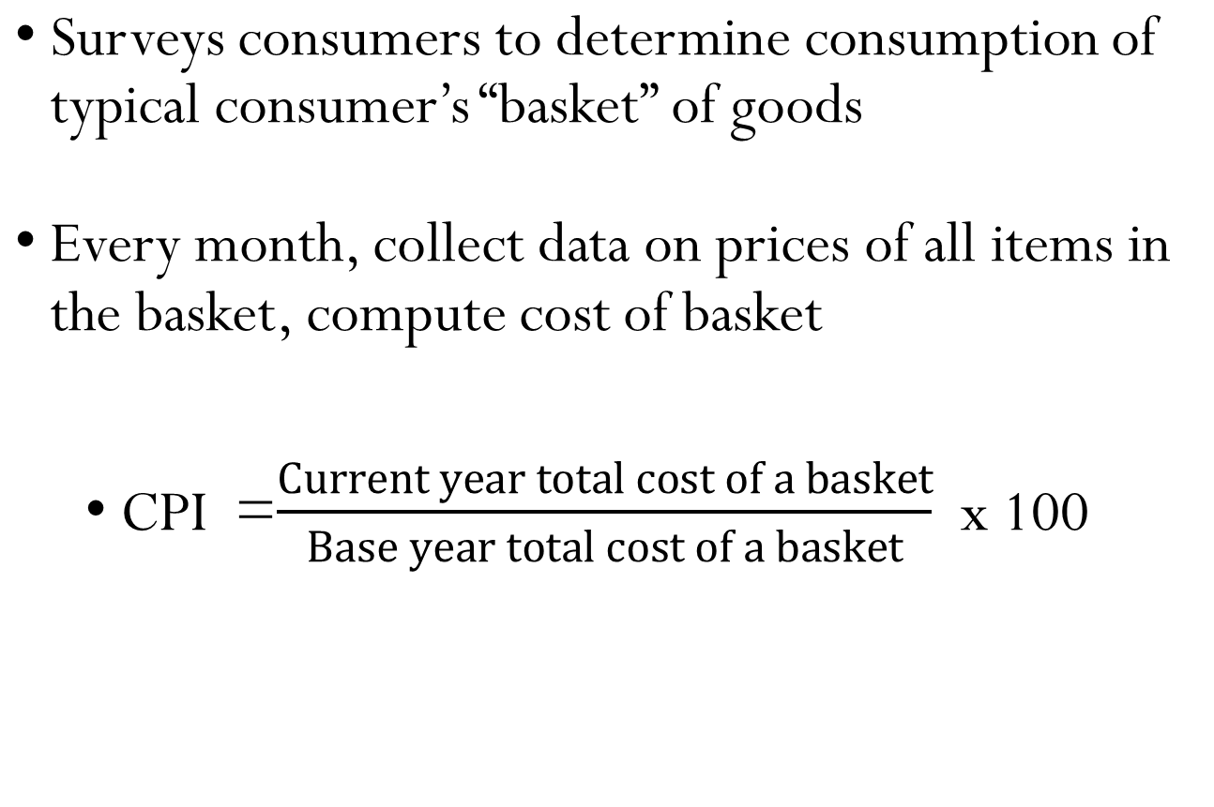
How the GSS constructs the CPI
Notes:
13

Slide 60
Calculation of the CPI: Example
Cost of basket of the current year (2000)
Good | Quantity (Basket) | Current per unit price | Cost in current year
Shirt | 10 | 5,000 | 50,000
Cement | 4bags | 12,000 | 48,000
Maize | 3bags | 7,000 | 21,000
Rice | 4bags | 9,000 | 36,000
Total |  |  | 155,000
Notes:
13

Slide 61
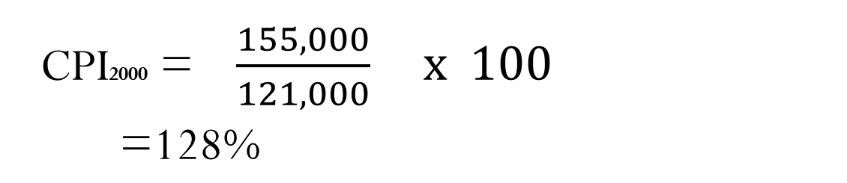
Calculation of the CPI: Example
Cost of basket in the base year (1990)
Good | Quantity (Basket) | Price of base year | Cost in base year
Shirt | 10bags | 3,500 | 35,000
Cement | 4bags | 9,200 | 36,800
Maize | 3bags | 6,000 | 18,000
Rice | 4bags | 7,800 | 31,200
Total |  |  | 121,000
Notes:
13

Slide 62
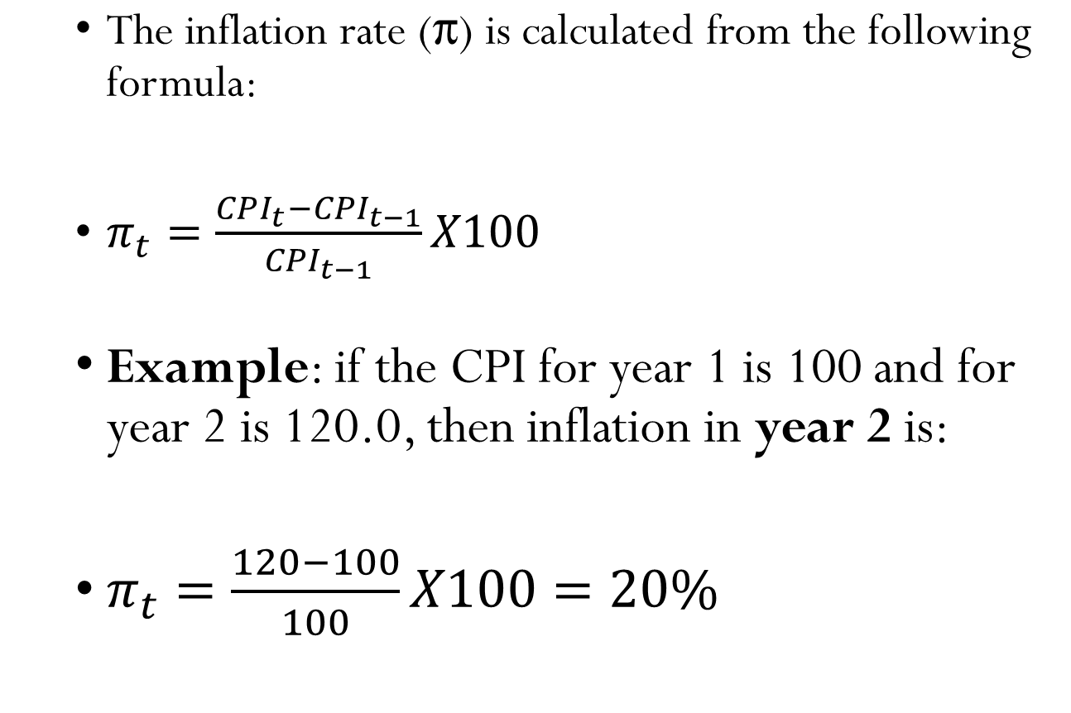
Calculation Inflation
Notes:
13

Slide 63
Type of Inflation
1. Suppressed Inflation
This type of inflation occurs when tough price and wage controls are introduced to prevent or restrain the price level from rising.
This does not eliminate the underlying inflationary pressures
2. Creeping Inflation
This type of inflation is experienced when the inflationary rate is fairly stable from year to year, averaging less than 5% with the price level gradually creeping upwards.

Slide 64
Type of Inflation
3. Strato – Inflation
In a strato-inflation, the inflation rate ranges from about 10% to several hundred percent without ever completely spiraling into a hyper – inflation.
4. Hyper – Inflation or Galloping Inflation
When the inflation rate accelerates to several hundred to many thousands percent per day, then we have hyper – inflation. Example Zimbabwe

Slide 65
Type of Inflation
5. Bottleneck Inflation
Bottleneck Inflation takes place when aggregate supply falls drastically and aggregate demand remains at same level.
Thus, rises in prices must be ascribed to supply bottlenecks (the increasing immobility of resources or mismanagement of resources) rather than to increase in aggregate demand.

Slide 66
Real GDP controls for Inflation
Changes in nominal GDP can be due to:
  changes in prices
  changes in quantities of output produced
Changes in real GDP can only be due to changes in quantities, because real GDP is constructed using constant base-year prices.

Slide 67
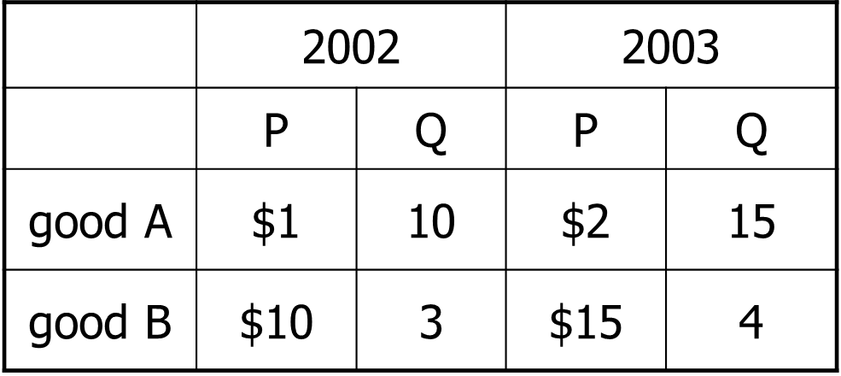
Practice Question
Compute Nominal GDP in 2002
Compute Real GDP in each years using 2002 as the base year

Slide 68
Answers to practice problem
Nominal GDP: multiply Ps & Qs from same year
2002: $1 x 10 + $10 x 3 = $40
2003: $2 x 15 + $15 x 4 = $90
Real GDP: multiply each year’s Qs by 2002 Ps
2002: $1 x 10 + $10 x 3 = $40
2003: $1 x 15 + $10 x 4 = $55
So in real terms, GDP did not rise as much as it would seem from nominal terms.

Slide 69
Exercise: Compute the CPI and inflation
The basket contains 20 bags of Cocoa and 10 bags of Rice
For each year,
1. compute
the cost of the basket
2. compute the CPI (use 2009 as the base year)
3. compute the inflation rate from the preceding year
Prices:
Cocoa Rice
2009 Gh¢10 Gh¢15
2010 Gh¢11 Gh¢15
2011 Gh¢12 Gh¢16
2012 Gh¢13 Gh¢15

Slide 70
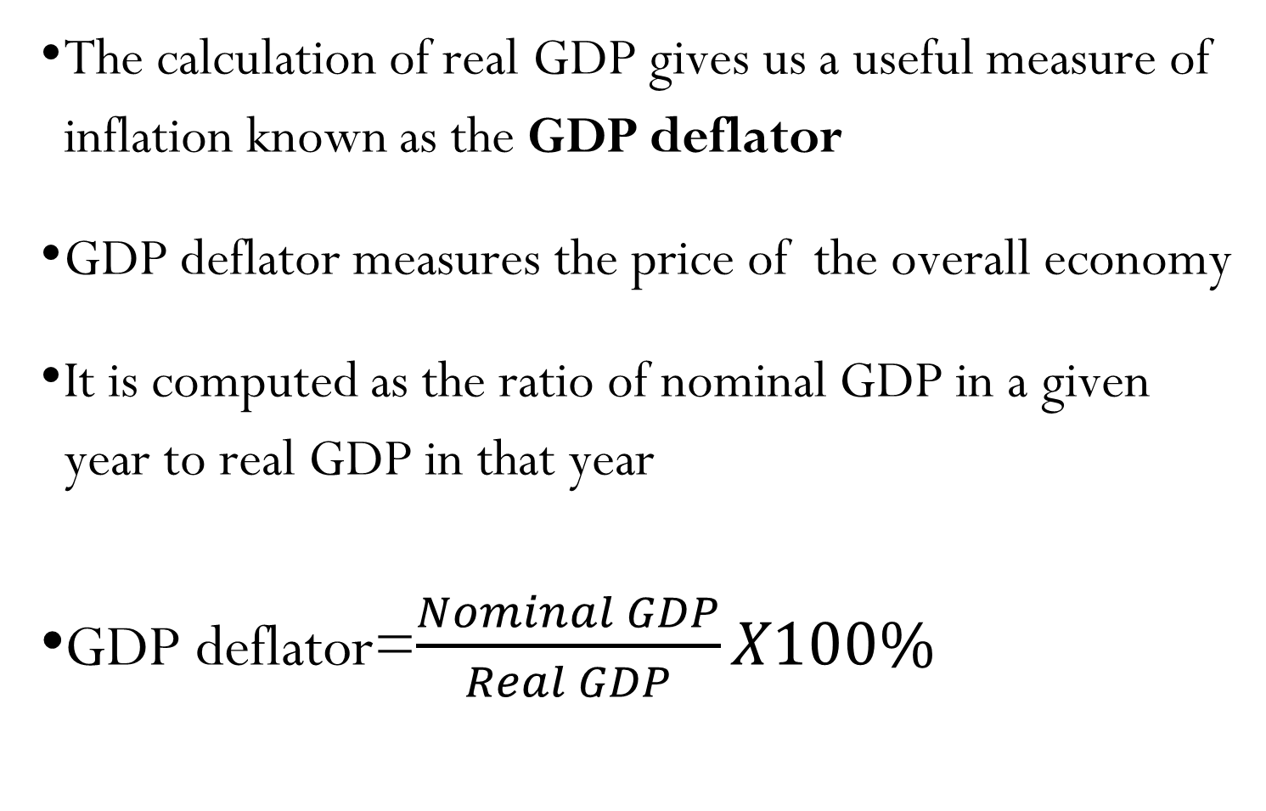
GDP Deflator

Slide 71
GDP deflator
Example: Computation of GDP deflator : Base year 1990
Type of good | Output (2000) | Price per Unit (¢) (2000) | Base year price (¢) (1990) | Nominal GDP | Real GDP
Computers | 20 | 1,500 | 1,200 | 30,000 | 24,000
Shirts | 200 | 500 | 300 | 10,000 | 60,000
Cement | 50bags | 800 | 550 | 40,000 | 27,500
Calculators | 40 | 700 | 630 | 28,000 | 25,200
 |  |  |  | 198,000 | 136,700
Notes:
14

Slide 72
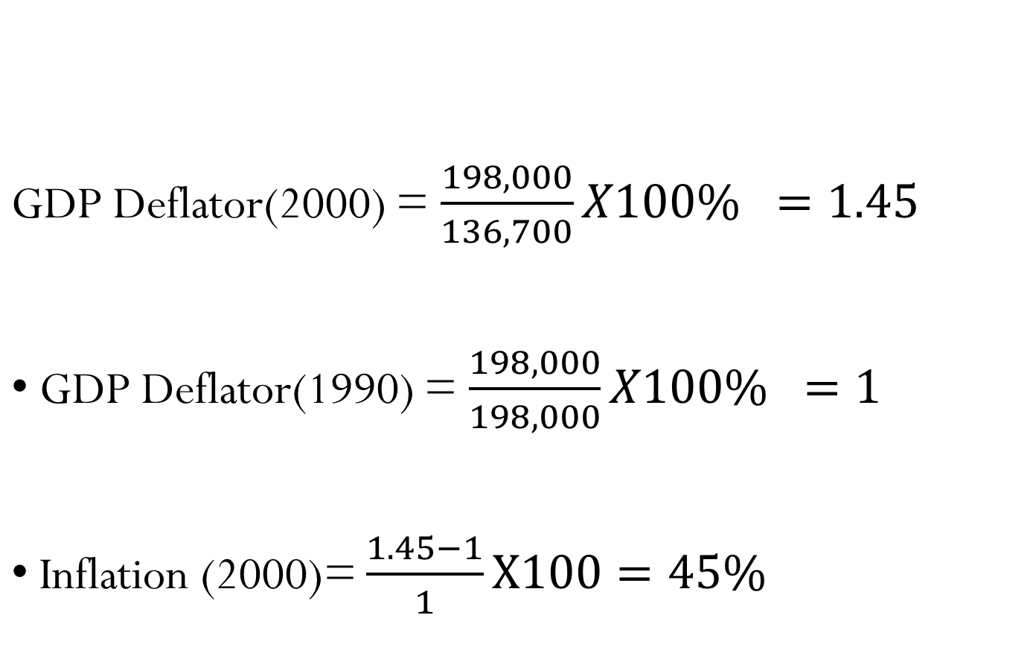
GDP deflator
Example: Computation of GDP deflator
Notes:
14

Slide 73
INFLATION
Causes of inflation
  Demand-pull Inflation: Demand-pull inflation is caused by continuing rises in aggregate demand.
  Causes of demand-pull inflation
    War
    Increase in exports and restrictions on Imports
    Rapid industrialization and economic Growth
    Increase in wages and salaries without a corresponding increase in output and rising population
Notes:
14

Slide 74
Demand-pull inflation
AS
Price level
P₁
AD₁
O
Q₁
National output

Slide 75
Demand-pull inflation
AS
Price level
P₁
AD₂
AD₁
O
Q₁
National output

Slide 76
Demand-pull inflation
AS
Price level
P₂
P₁
AD₂
AD₁
O
Q₁
Q₂
National output

Slide 77
INFLATION
Causes of inflation
Cost-Push inflation: is associated with continuing rises in costs and hence continuing leftward (upward) shifts in the AS curve. Such shifts occur when costs of production rise independently of aggregate demand.
    Causes of cost-push inflation:
    Wage-push inflation
    Profit-push inflation
    Import-price-push inflation
    Tax-push inflation
    The exhaustion of natural resources
Notes:
14

Slide 78
Cost-push inflation
AS₁
Price level
P₁
AD
O
Q₁
National output

Slide 79
Cost-push inflation
AS₂
AS₁
Price level
P₁
AD
O
Q₁
National output

Slide 80
Cost-push inflation
AS₂
AS₁
Price level
P₂
P₁
AD
O
Q₂
Q₁
National output

Slide 81
INFLATION
  Interaction of demand-pull and cost-push inflation
  Assume that powerful groups are constantly pushing up the costs of production.
  At the same time, assume that the government, in order to prevent a rise in unemployment, is constantly boosting the level of aggregate demand (say, by cutting taxes)
  The net effect on output and employment may be very small, but prices may rise substantially
Notes:
14

Slide 82
The interaction of demand-pull and cost-push inflation
AS₁
Price level
P₁
AD₁
O
National output

Slide 83
The interaction of demand-pull and cost-push inflation
AS₂
AS₁
Price level
P₂
P₁
AD₂
AD₁
O
National output

Slide 84
The interaction of demand-pull and cost-push inflation
AS₃
AS₂
AS₁
P₃
Price level
P₂
P₁
AD₃
AD₂
AD₁
O
National output

Slide 85
INFLATION
Policies to tackle inflation
  Demand-side policies
    fiscal and monetary policies
  Supply-side policies
    Restrictions on Factor Price Increases (e.g., Wage Freeze )
    Introduction of Efficient Production Methods
Notes:
14

Slide 86
Thank You
Notes:
14

